Slide 1
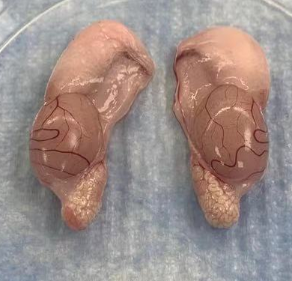
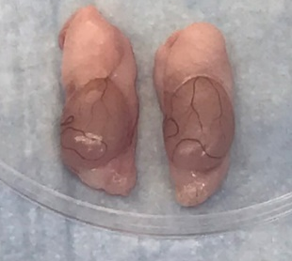
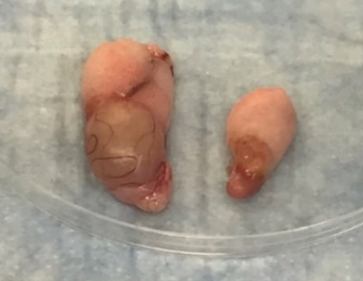
1000 SARS-CoV-2 given intranasally; appearance of testes at 120 days after infection
No SARS-CoV-2 infection;
Normal sized testes of hamster
at the same age
SARS-CoV-2 infection after 120 days: marked decrease in size of both testes
SARS-CoV-2 infection after 120 days: marked decrease in size of both testes but the left one is particularly small

Slide 2
睾丸重量
血睾丸酮水平
精子數量
倉鼠感染COVID-19後42天和120天,
雖然 肺炎完全康復,
但睾丸重量、血睾酮水平和精子數顯著降低，

Slide 3
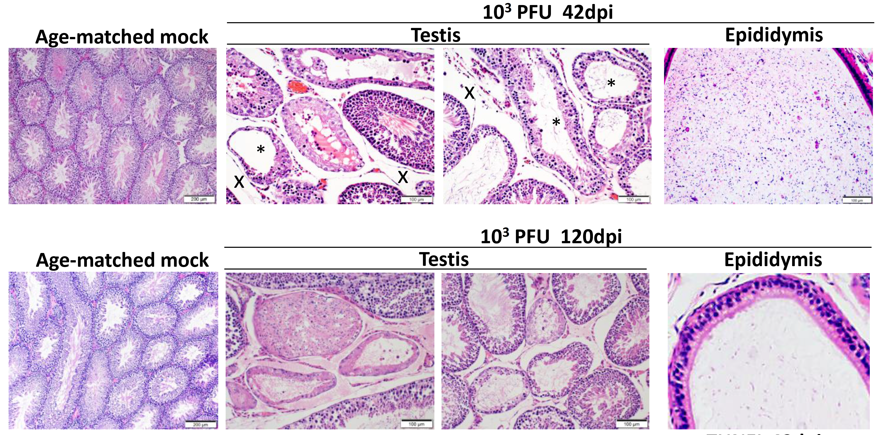
正常對照組
第42天病毒感染組
正常對照組
第120天的病毒感染組
Under the microscope at 42dpi, testes showed severe diffuse seminiferous tubular epithelial necrosis; spermatogenic cells were depleted; tubular lumen contained little amount of spermatozoa; epididymal lumen contained large amount cell debris.
Under the microscope at 120dpi, germinal epithelium of seminiferous tubules showed atrophy and loss of normal differentiation spectrum. The epididymal lumen showed no sperm.
顯微鏡下第42天病毒感染組: 睾丸曲細精管上皮壞死；生精細胞被耗盡；管腔內含有少量精子；附睾管腔內含有大量細胞碎片。第120天的病毒感染組: 睾丸曲細精管上皮萎縮，正常分化。附睾管腔未見精子。

